Slide 1

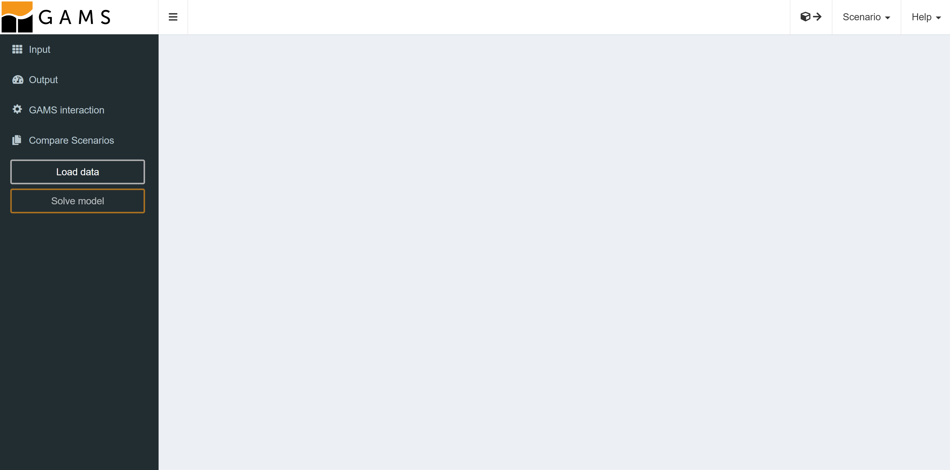
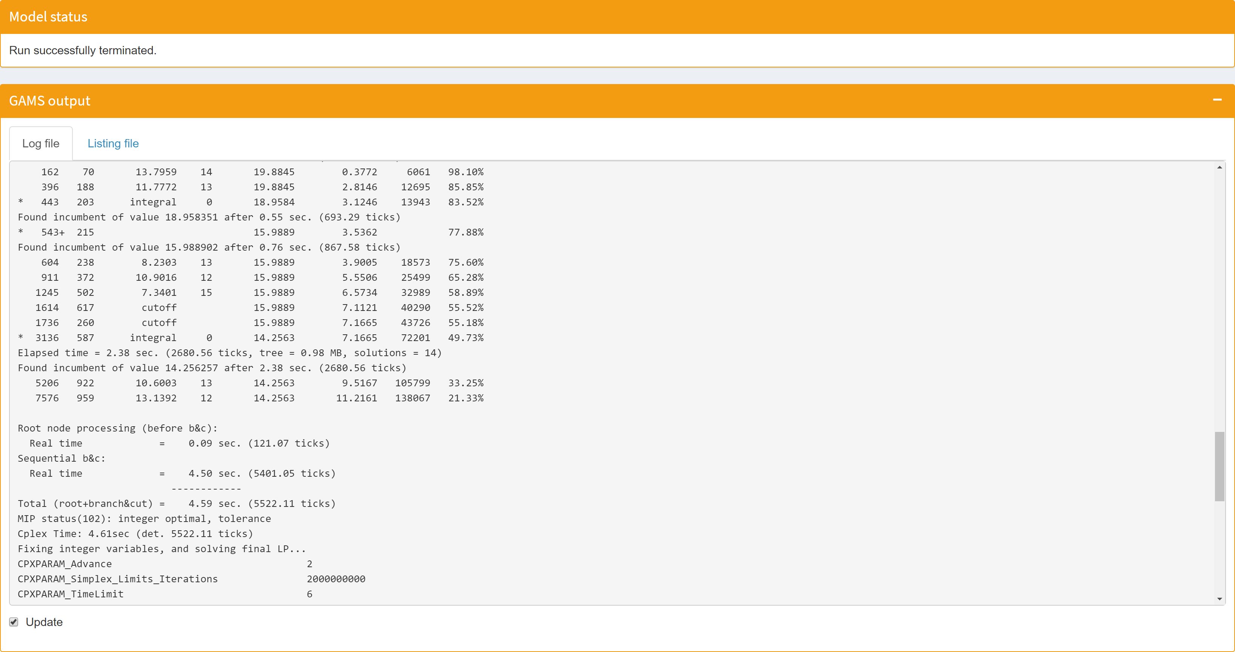
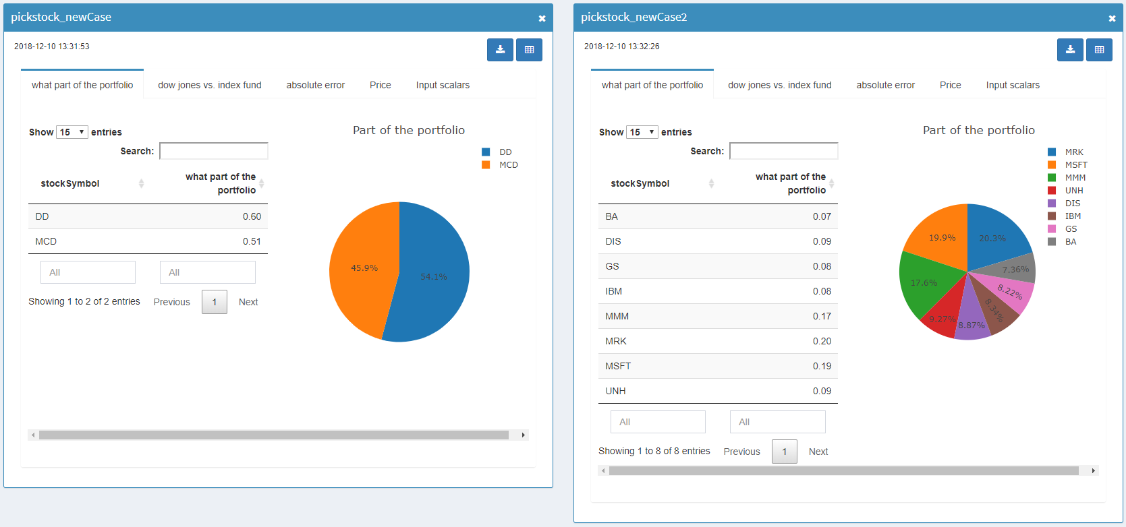
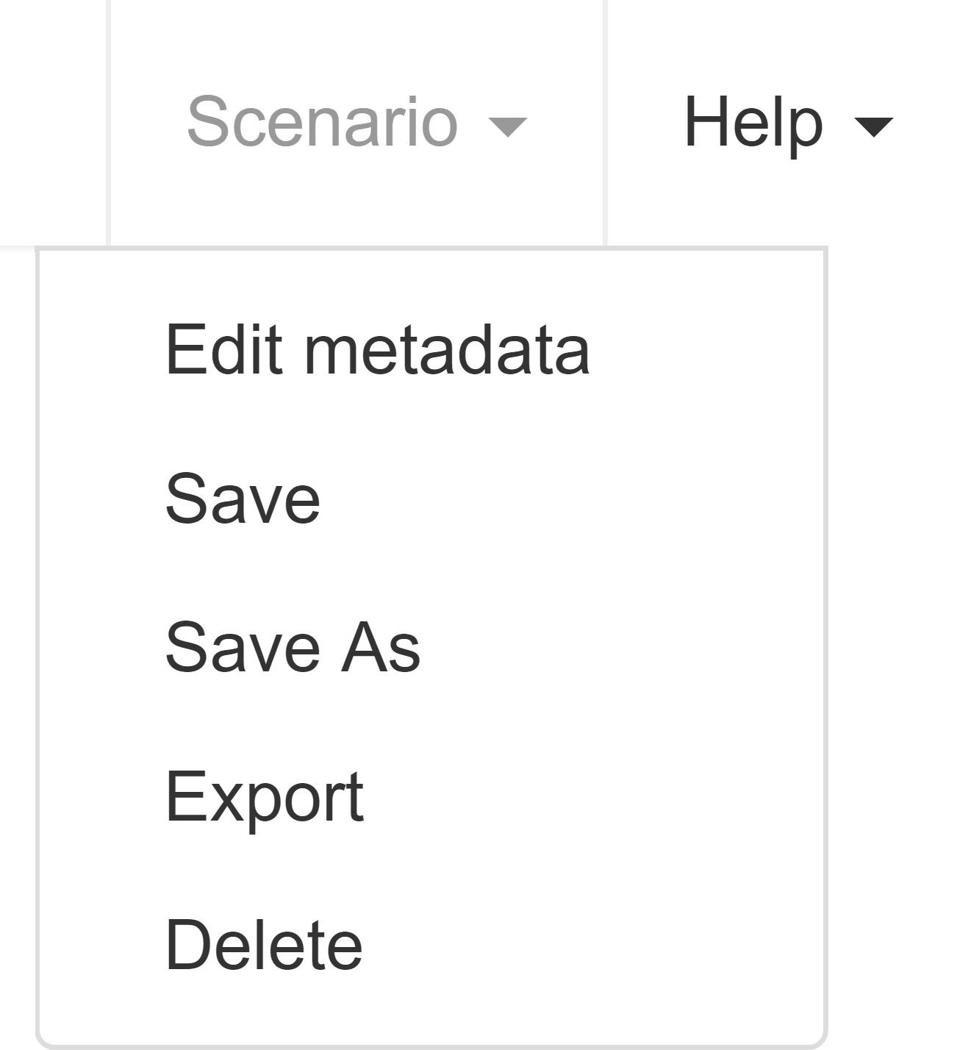
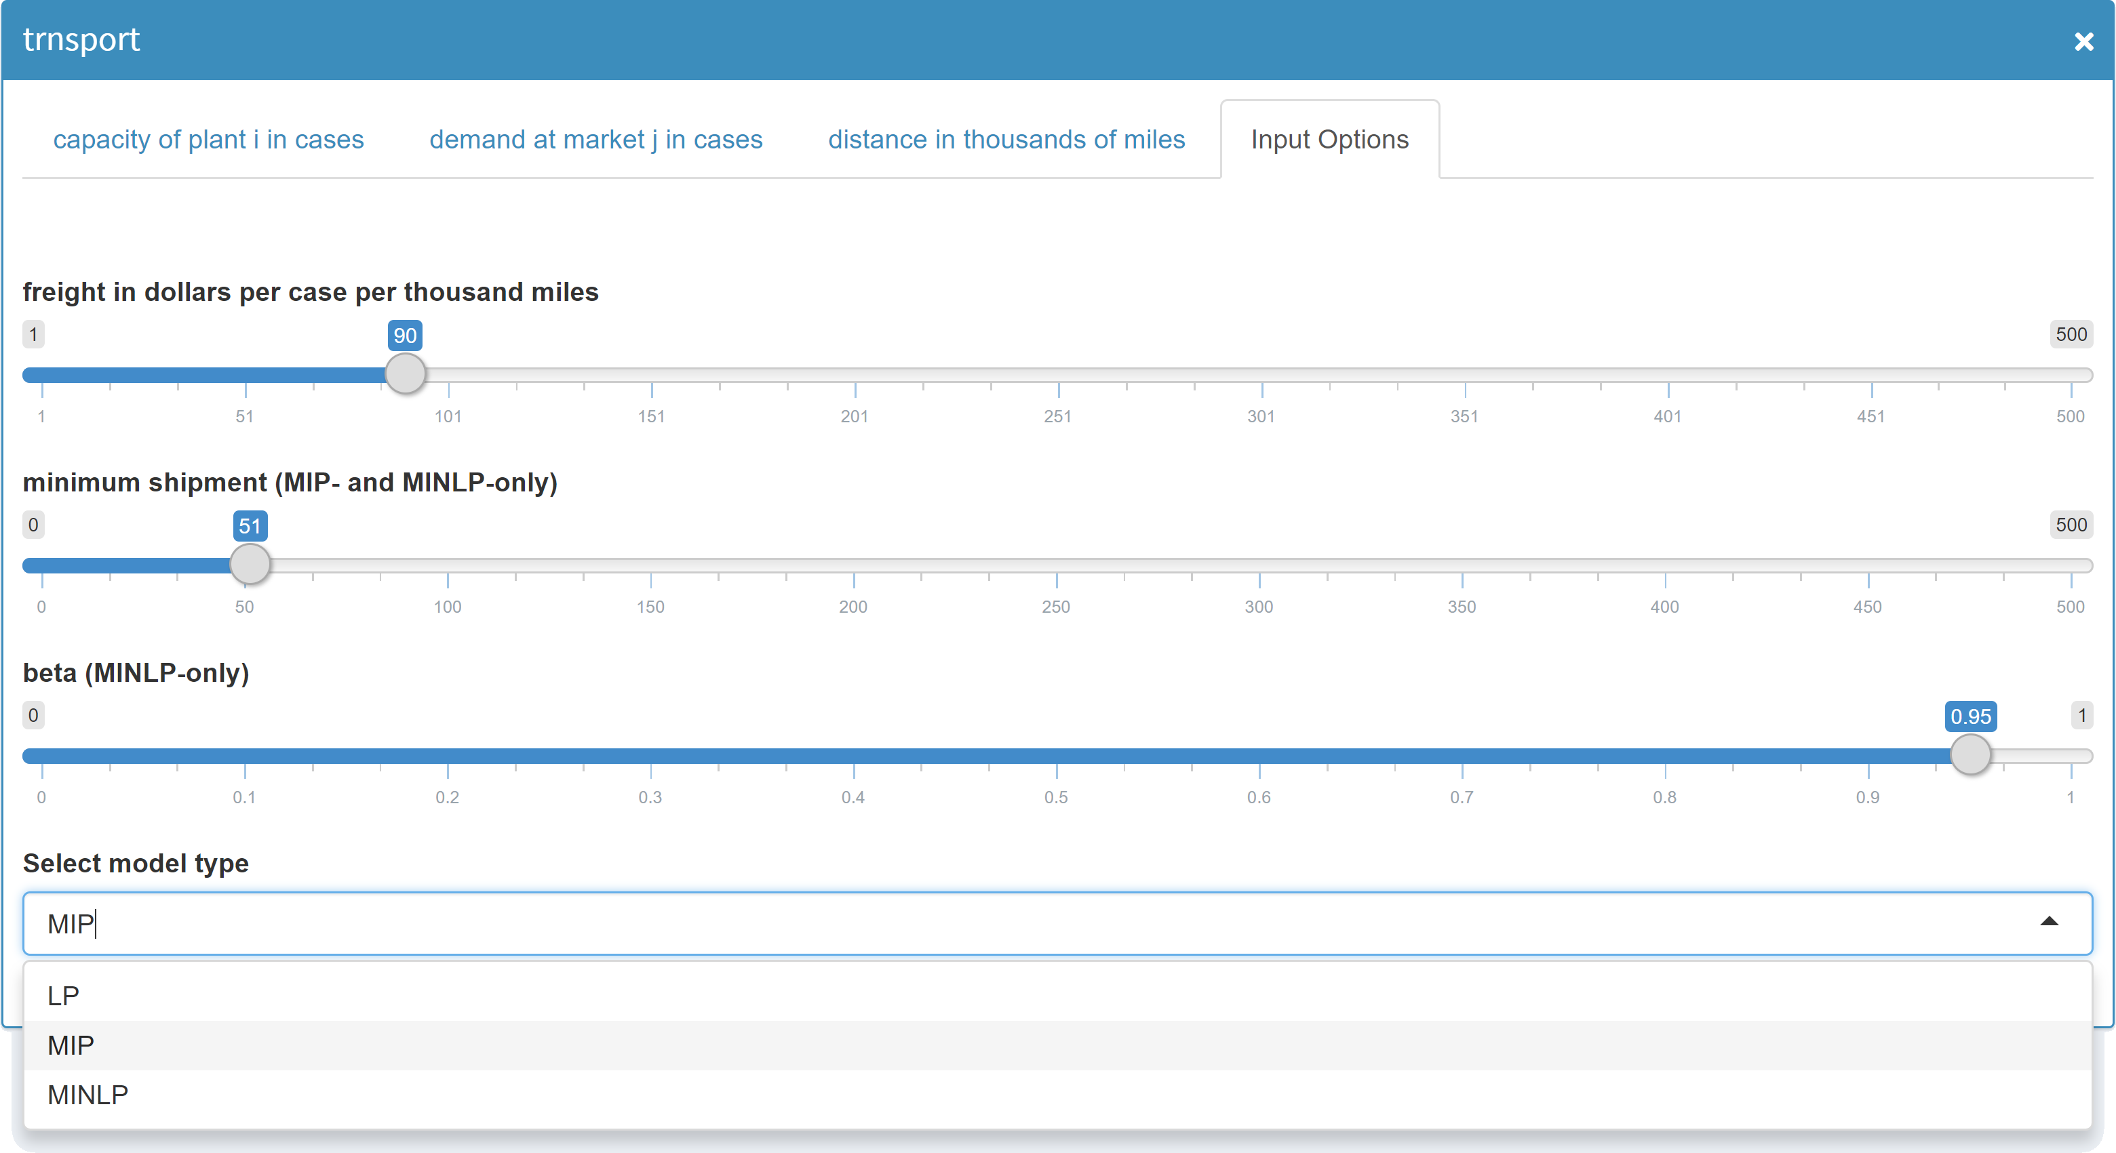
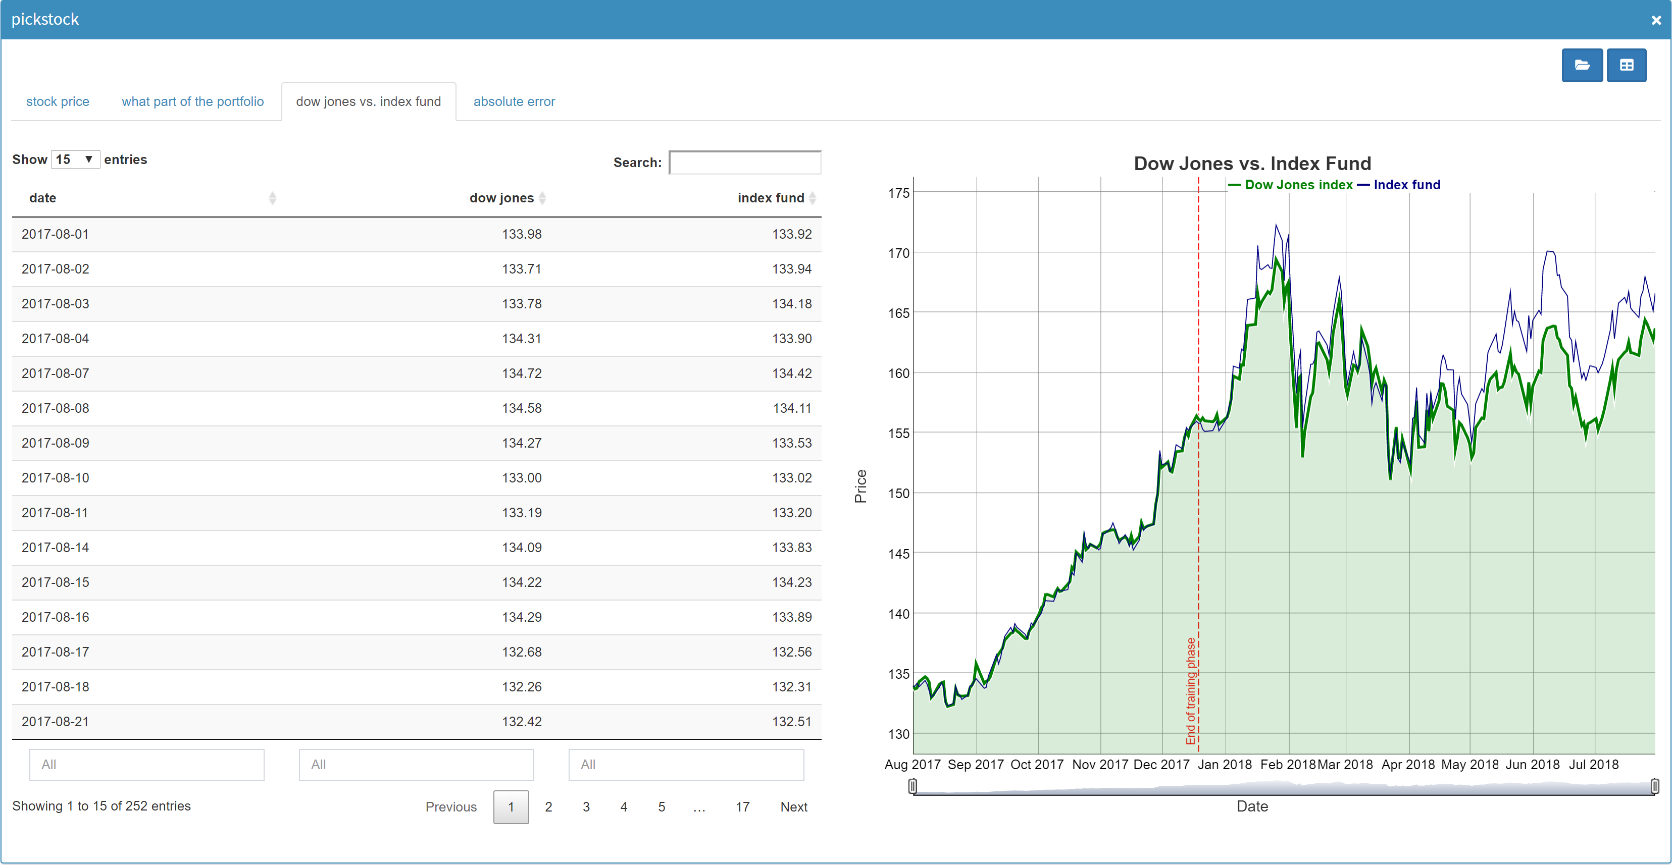
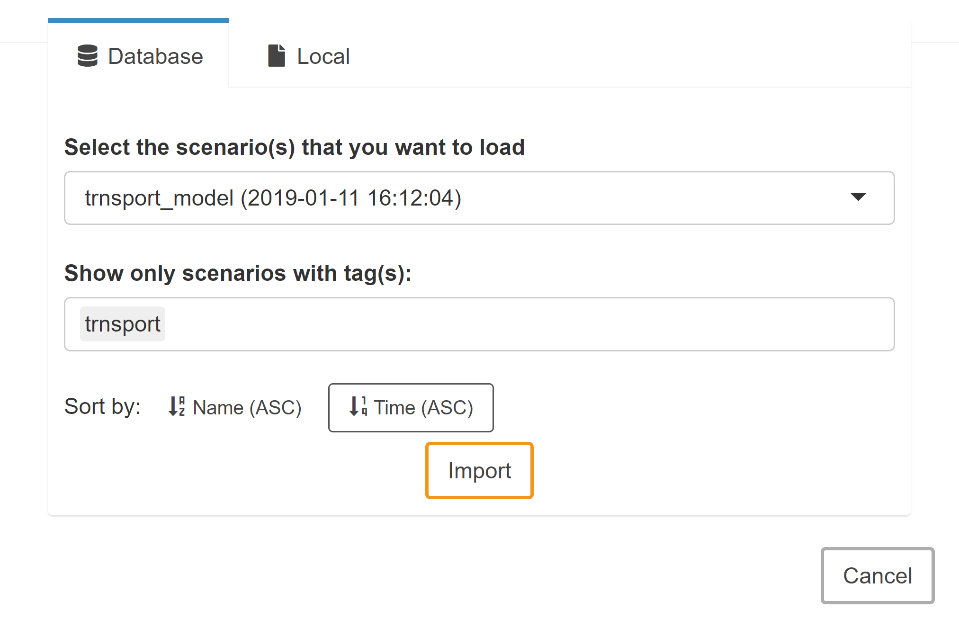
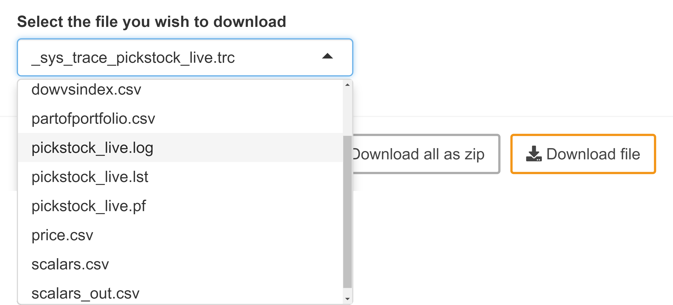
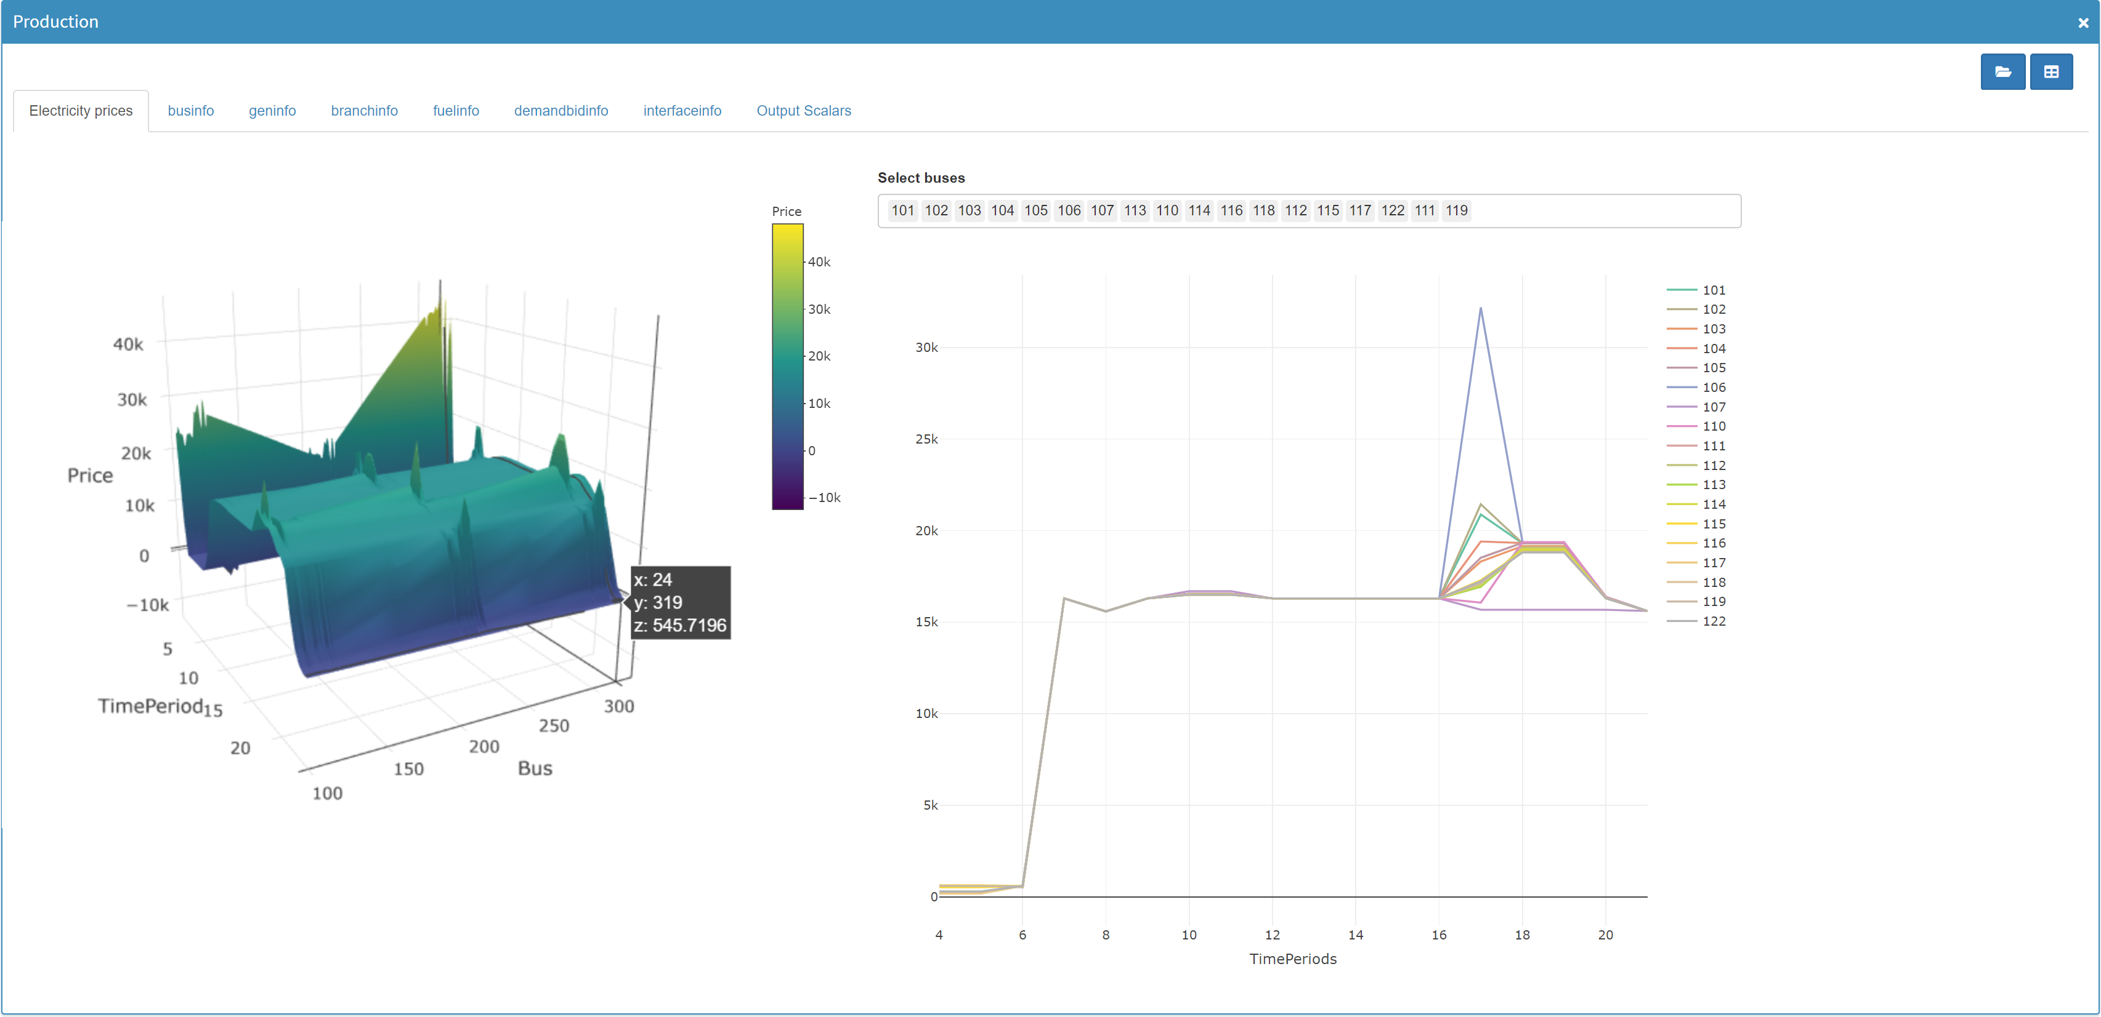
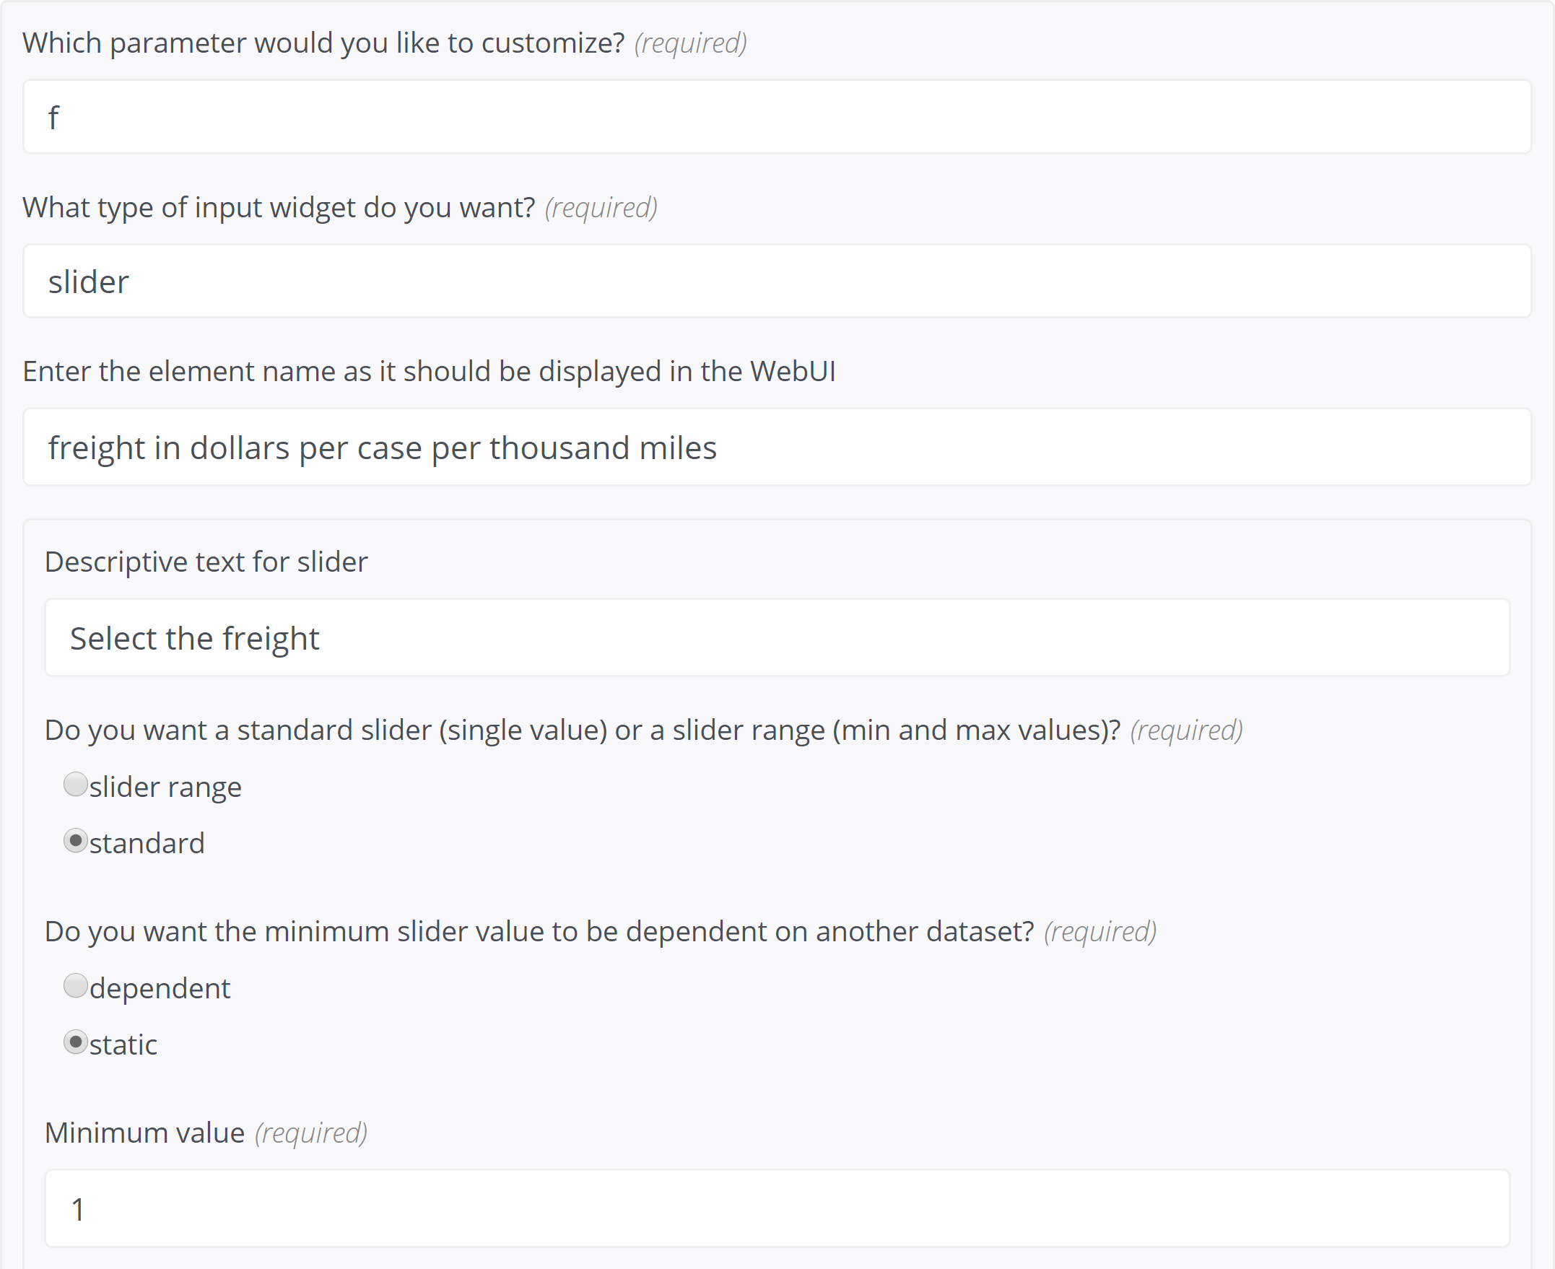
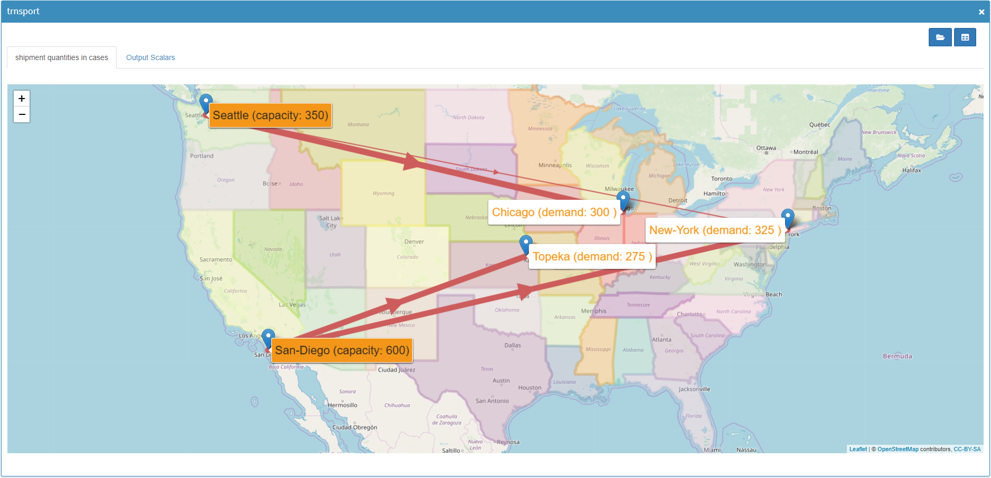
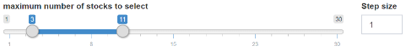
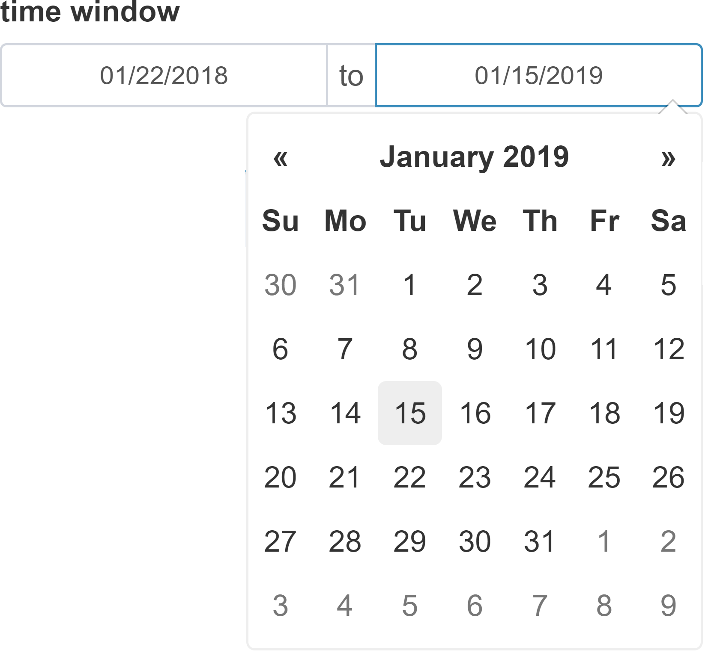
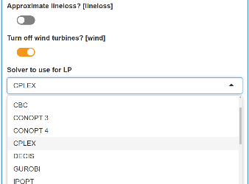
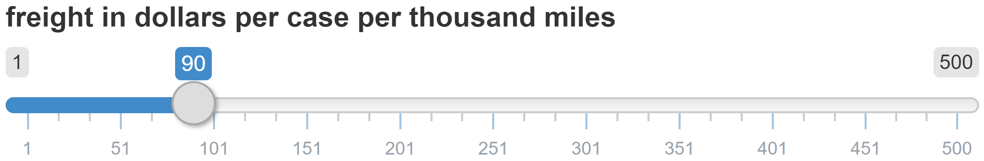
miro || cheat sheet
GAMS interaction
Compare Scenarios
Customizable Logo
Direct access to GAMS output files
Compare scenarios from the database in split screen and tab-view
Basics:
Hide Sidebar
Model status message
Log file
Listing (lst) file
Download scenario data (Excel)
Close scenario
Switch to Hypercube mode
The GAMS WebUI is a graphical user interface (GUI) for GAMS models that runs inside your browser.
Documentation
Key features:
Scenario management
Quick & automated deployment of GAMS models
Data visualization with powerful graphics
Sophisticated generation, processing, evaluation & storing of scenario data
Intuitive planning without GAMS knowledge
Easy to use & comfortable working environment
Scenario – database interaction
Save / save as
Edit metadata (name / tag) of a scenario ➞ allows file attachments to a scenario
Delete scenario
Export scenario data
Load data
Switch between graphical and raw data representation
Import data from database and locally saved files
Download temporary files
All files of the working directory
Solution reports
GAMS Log & Lst file
[…]
Import from database
Import from Spreadsheet
Selected data set
Specified tag
Start GAMS run
Input data tabs
Dropdown menu
Slider
Filter results
Table page navigation
Output data tabs
Graphic and corresponding data in one screen or separated
Sort database entries
Start Import
Cancel Import
Input
Output
Visualization & configuration of input data for the next calculations
Visualization of results
How to get there
Annotating the GAMS model
Configuration
Custom Graphics
Flag input data with $onExternalInput / $offExternalInput tags
Flag output data with $onExternalOutput / $offExternalOutput tags
Include the file webui (GAMS include library) at the end of the model
WebUI configuration & customization via JSON file config.json – you can generate JSON with the configuration generator
Input widgets:
Table
Slider / slider range
(Multi) dropdown menu
Date (range) selector
Checkbox
Text input
[…]
An R API provides extensive visualization options (custom renderers).
General appearance
Input widgets
Graphics
Functionality
Language
[…]
[…]
$onExternalInput
Parameters a(i) 'capacity of plant i in cases' / seattle 350
san-diego 600 /
Scalar f 'freight in dollars/case per 1000 miles' /90/ ;
$offExternalInput
[…]
$onExternalOutput
Variables x(i,j) 'shipment quantities in cases'
z 'total transportation costs in 1000$’ ;
Scalar f 'freight in dollars per case per thousand miles' / 90 /
$offExternalOutput
[…]
Solve transport using lp minimizing z;
$libInclude webui
Configuration Generator
Graphics (pre-implemented):
Data table
Pie chart
Bar chart
Line chart
Scatter plot
Histogram
Pivot table
{
"inputWidgets": {
"f": {
"widgetType": "slider",
"alias": “freight in dollars per case per thousand miles",
"label": "Select the freight",
"min": 1,
"max": 500,
"default": 90,
"step": 1
}
}
}
Generated JSON
Launch:
Via GAMS command line: --miro=launch
Via created shortcut of model app
GAMS Software GmbH
www.gams.com
info@gams.com
Learn more at www.gams.com/miro
miro version 0.2.8
Updated: 2-19-01-28
Resulting Input widget
base mode

Slide 2

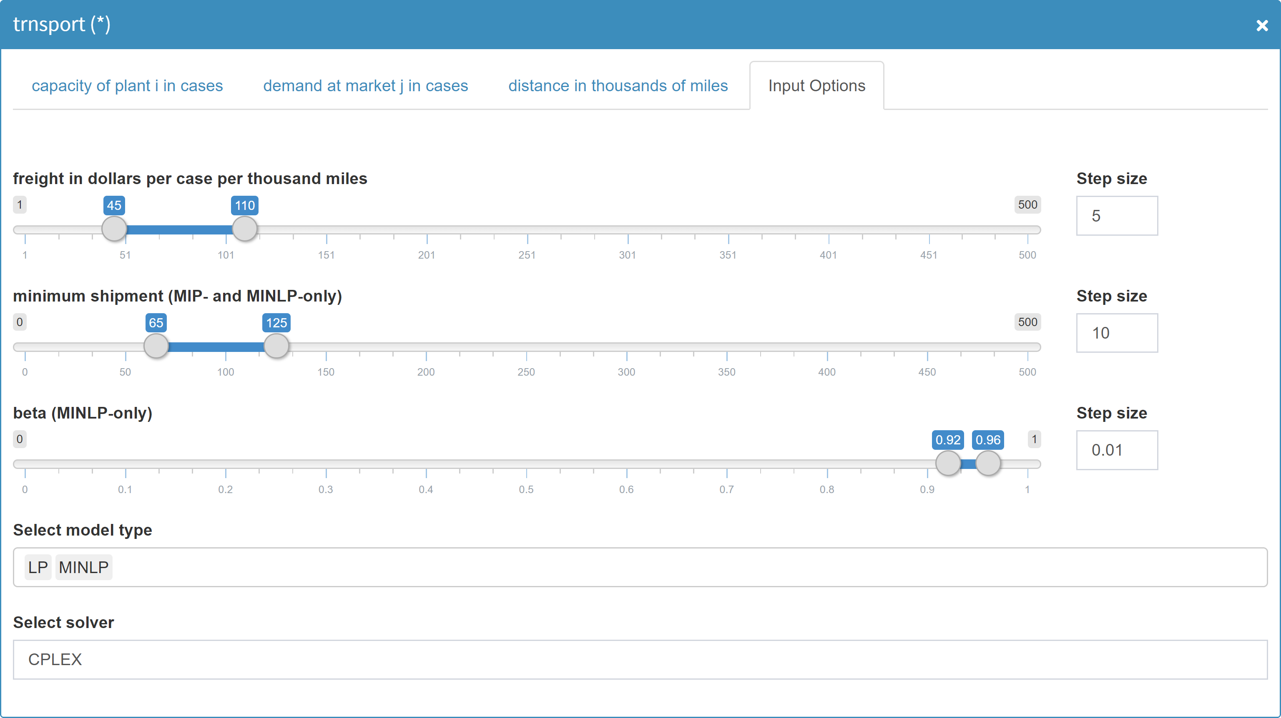
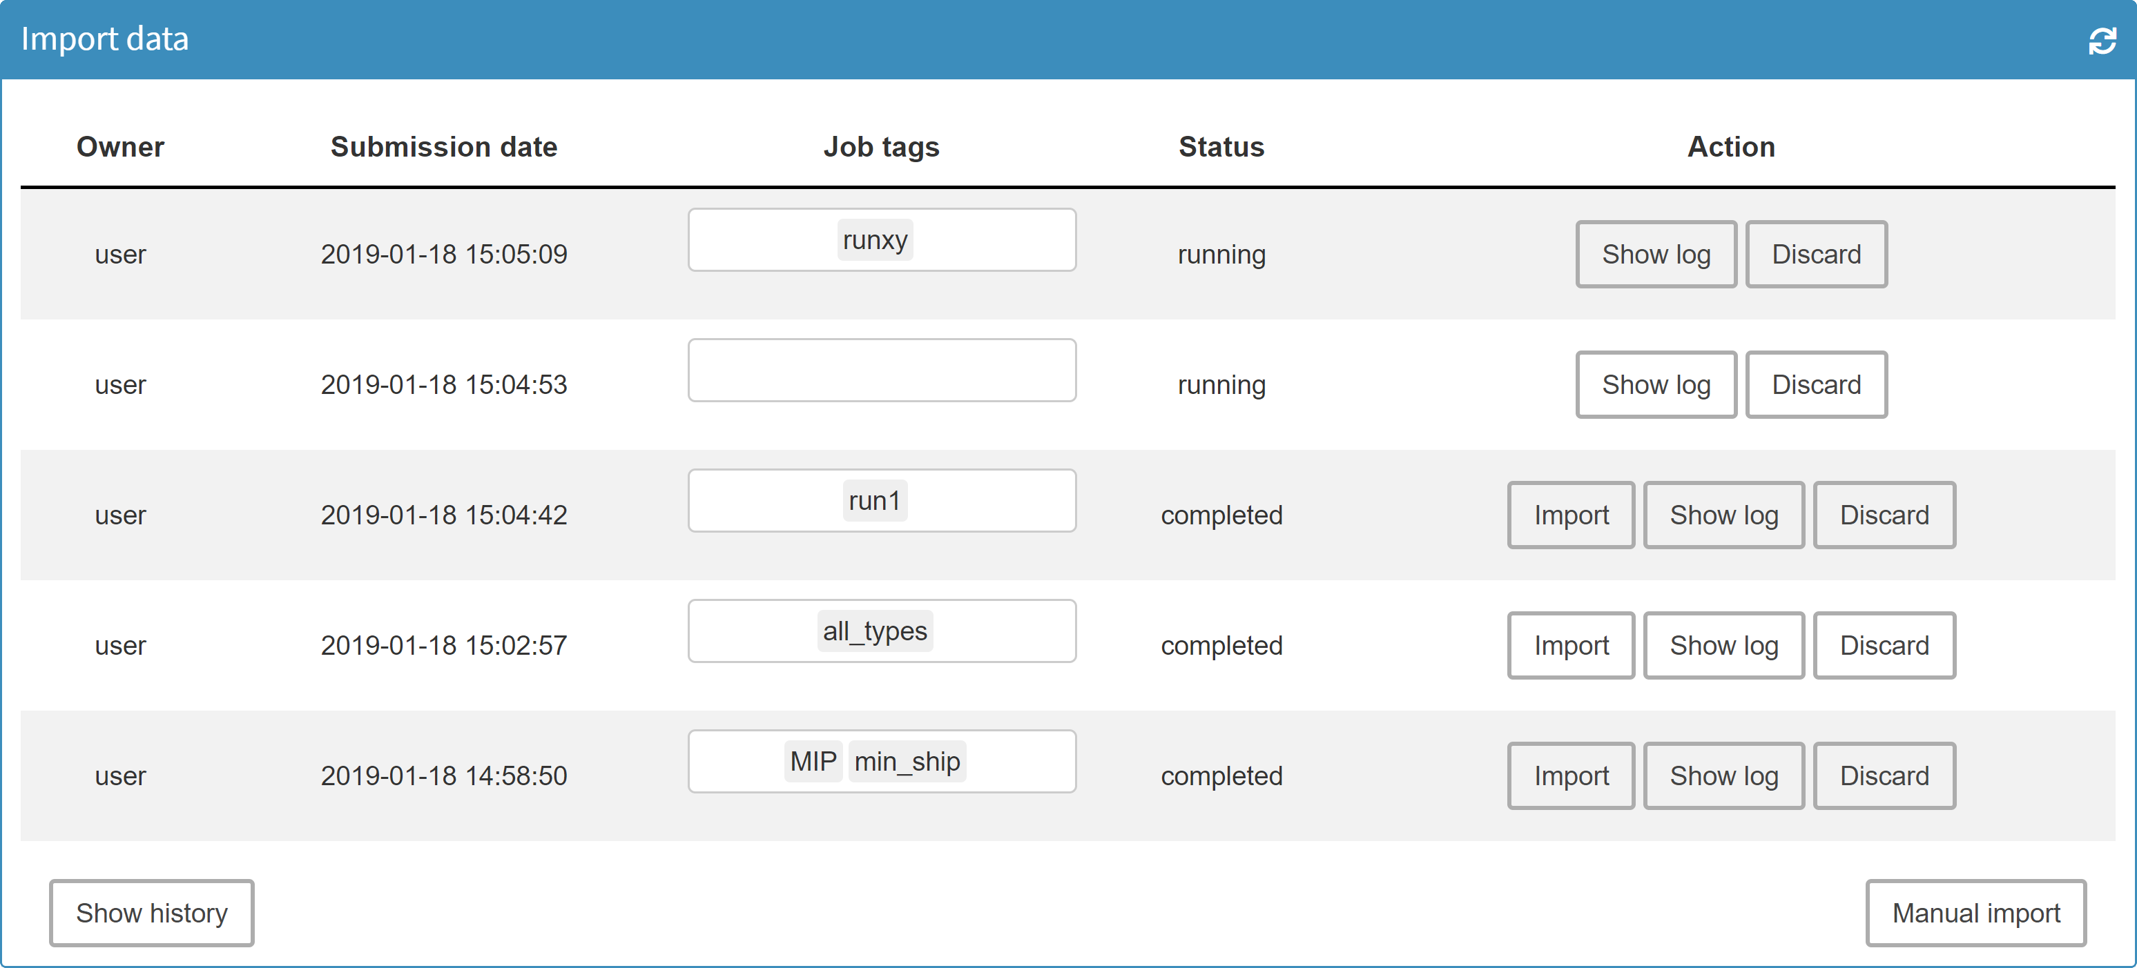
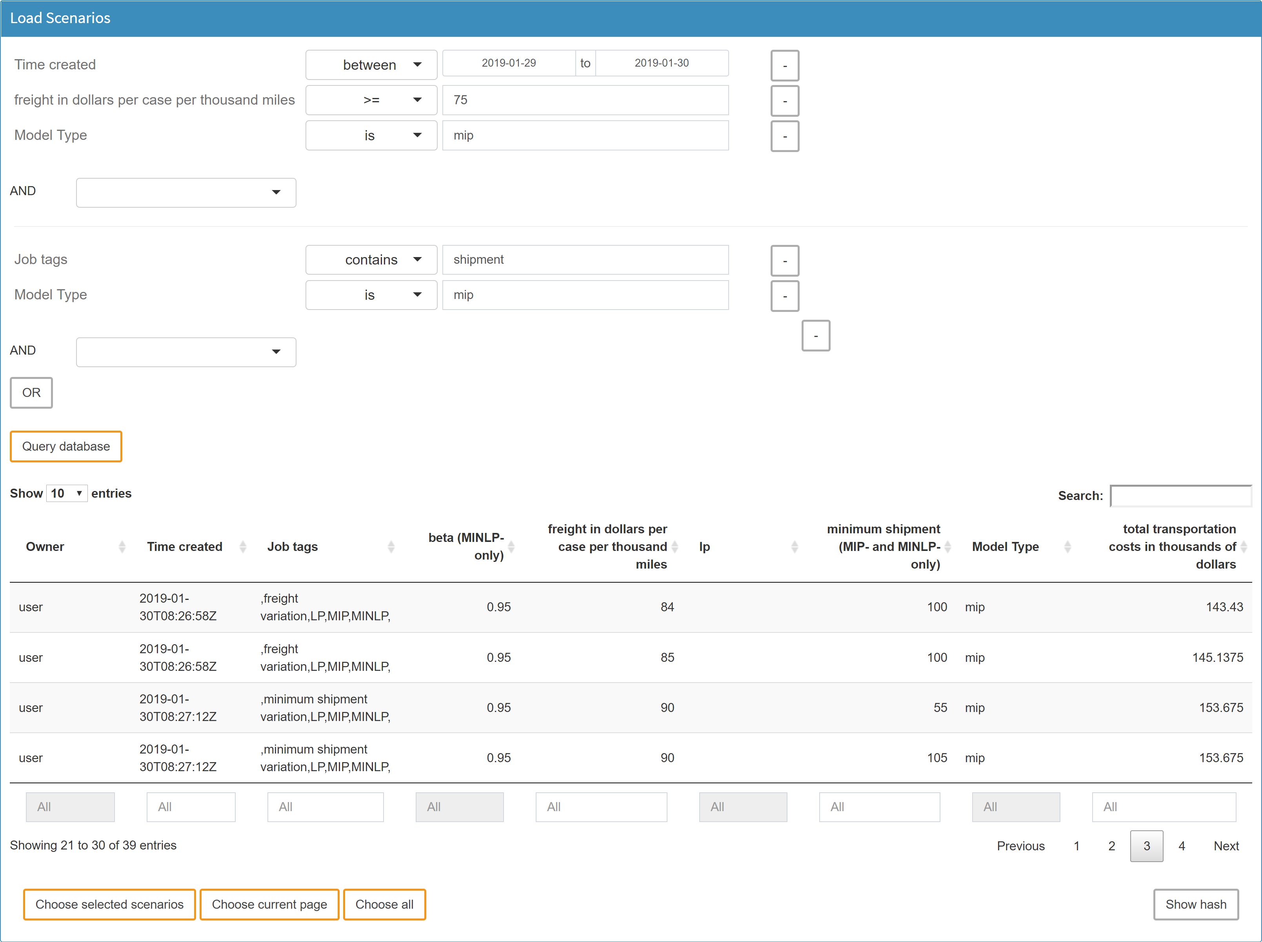
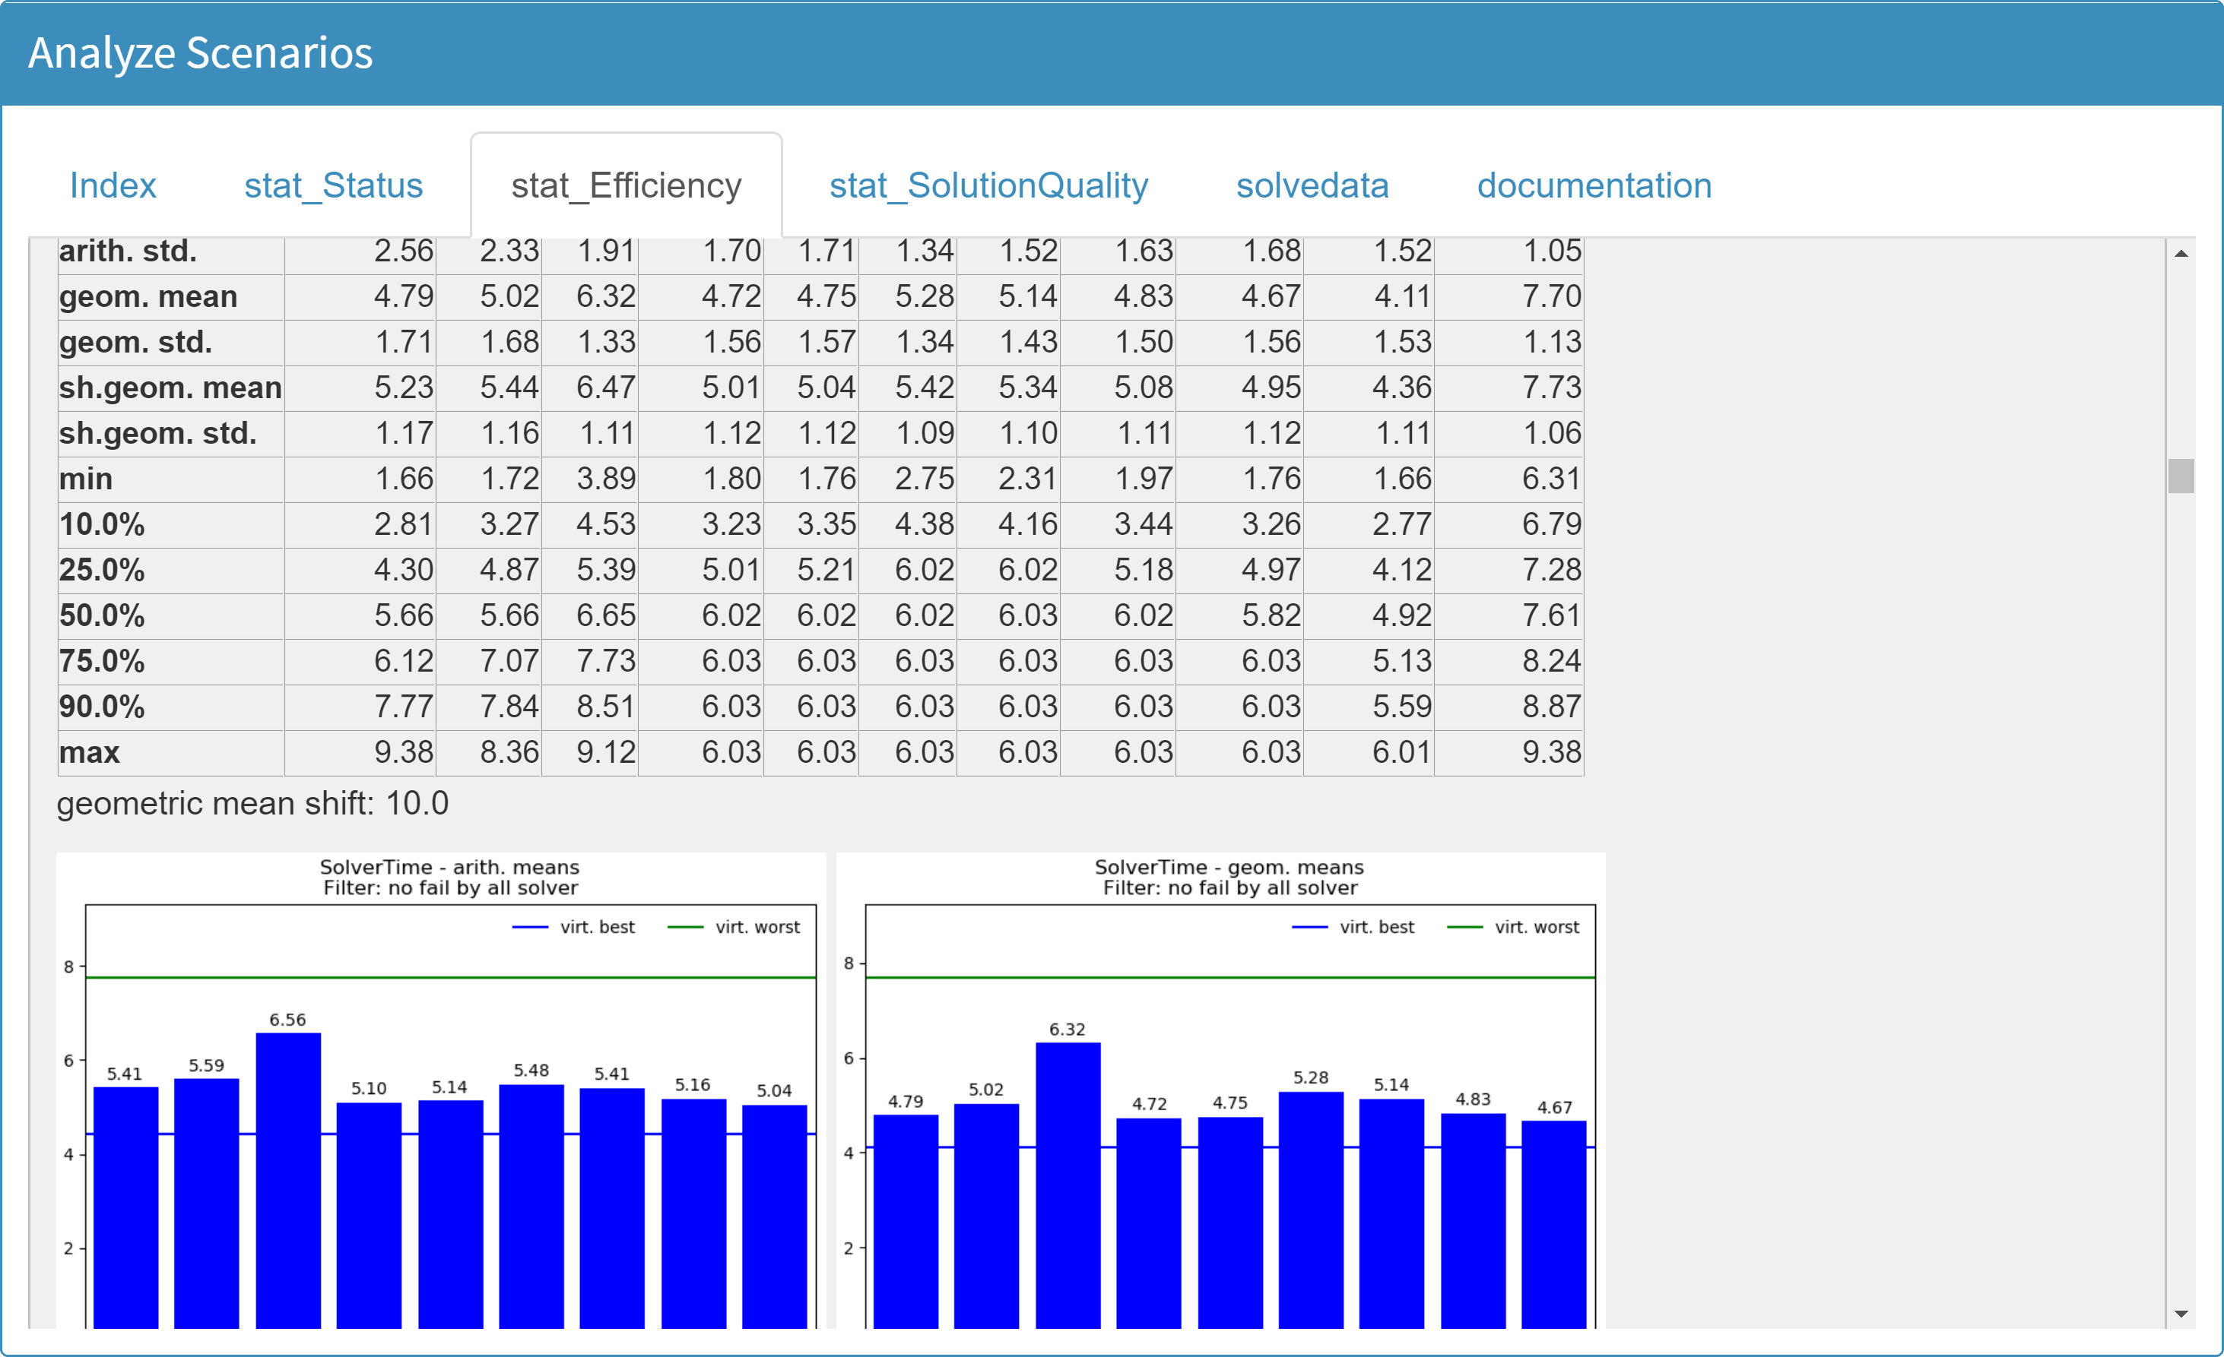
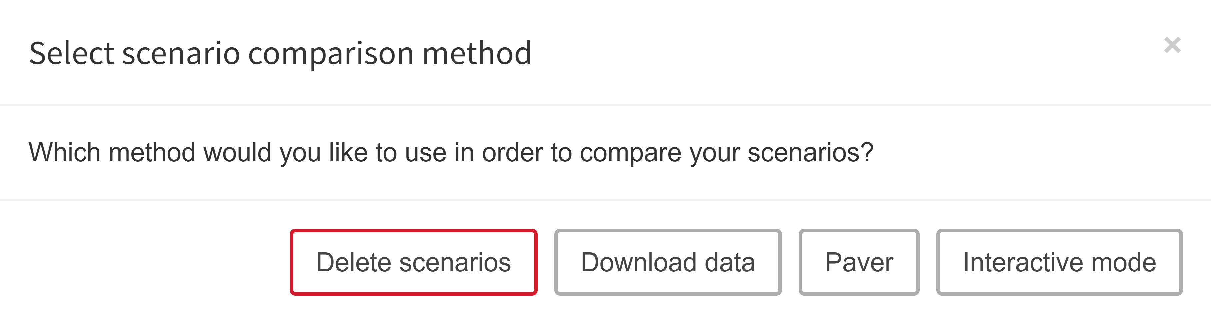
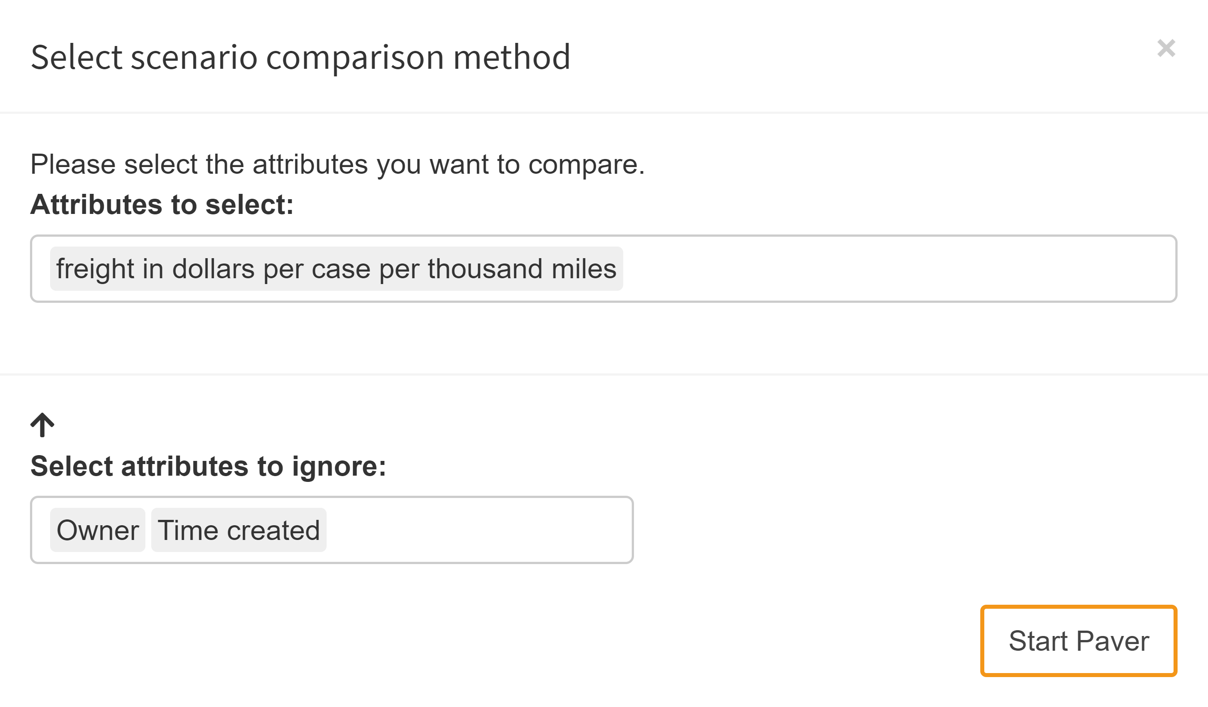
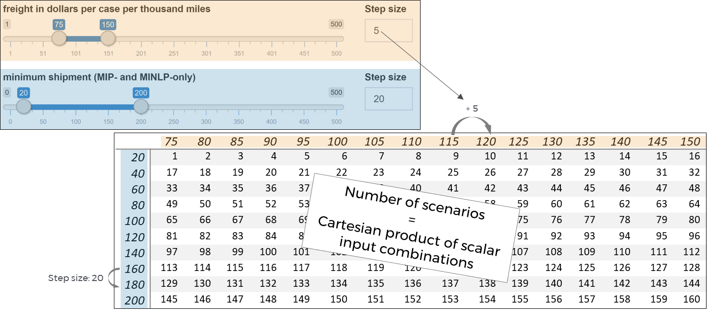
miro || cheat sheet
Basics:
Key features:
Launch:
The Hypercube mode enables the user to create, solve and analyze a multitude of model scenarios at once. The tool facilitates structured work with large amounts of data.
Simple creation of multiple scenario parameterizations
Automated (or manual) submission of the GAMS job
Analysis of the parameter range of a model
Automated creation & analysis of performance statistics
Easy and convenient management of scenario data
Via miro base mode: click on button in the upper right
Via GAMS command line:
--miro=launch --miromode=hcube
shortcuts
Simplified navigation through the user interface
Option | Shortcut
Confirm | ENTER
Close Pop up | ESC
Import | Ctrl + ALT + I
Solve | Ctrl + ALT + ENTER
Save | Ctrl + ALT + S
Save as | Ctrl + ALT + S
Remove | Ctrl + ALT + R
Close | Ctrl + ALT + C
Hide sidebar | Ctrl + ALT + F
“Input” (sidebar) | Ctrl + ALT + 1
“Output” (sidebar) | Ctrl + ALT + 2
“GAMS interaction” (sidebar) | Ctrl + ALT + 3
“Compare scenarios” (sidebar) | Ctrl + ALT + 4
“Configure Hypercube job” (sidebar) | Ctrl + ALT + 1
“Import results” (sidebar) | Ctrl + ALT + 2
“Load results” (sidebar) | Ctrl + ALT + 3
“Compare scenarios” (sidebar) | Ctrl + ALT + 4
“Analyze scenarios” (sidebar) | Ctrl + ALT + 5
Table view (section scenario compare) | Ctrl + ALT + T
Select next tab (table view) | Ctrl + ALT + arrow right
Select precious tab (table view) | Ctrl + ALT + arrow left
Nest to next lower tab | Ctrl + ALT + arrow down
Unnest to next higher tab | Ctrl + ALT + arrow up
Activate / deactivate comparison mode | Ctrl + ALT + space
Compare scenarios
Configure Hypercube job
Import results
Refresh page
Same scenario comparison as in
➞ base mode
Creation of multiple scenario parameterizations
Scalar input data
Add, edit, delete job tag(s)
Overview and import of submitted Hypercube jobs
Base mode: single dropdown
Hypercube mode: multi dropdown
Base mode: single slider
Hypercube mode: slider range
Import calculated scenarios
Show log of job calculations
Discard Hypercube job
Non-scalar input data (parameters, sets, multi-dimensional singleton sets)
Boolean AND
Slice and dice scenarios in database
Show job history
Boolean OR
Text input field
Sort list
Query database
Submit configured Hypercube job
Select all listed scenarios
Search for a scenario in list
Show the hash value of one selected scenario
Performance analysis by PAVER
Manual scenario data import (ZIP file)
Import data (see base mode)
Choose marked scenarios with cursor (cross-page)
Select scenarios of current page
Load results
Analyze scenarios
Graphical database query. Slice & dice the database to fetch scenarios and analyze them.
Integrated performance analysis tool PAVER
Analyzing method
PAVER options:
PAVER comparison attributes
Scenario generation
Delete selected scenarios
Compare scenarios in split / tab view
Step size of slider range for scenario generation
Download scenario data for external analyses
Analyze scenarios with PAVER
GAMS Software GmbH
www.gams.com
info@gams.com
Learn more at www.gams.com/miro
miro version 0.2.8
Updated: 2-19-01-28
Start PAVER analysis
hypercube mode
Attributes to ignore by PAVER (optional)

